Slide 1
WEATHERLY
An exercise in Back-End development with cloud technologies

Slide 2
About Me
Hugo De Moraes := <He/Him>
Rising Junior at Rutgers University studying Computer Science
Pursuing a career in Full-Stack Software Engineering
Interested in problems revolving around logistics, transportation, and the overall movement of people
Out in Tech Graduate!

Slide 3
What I learned
Backend Layer
Database Layer
3rd Party Service Layer
How to build a simple Express.js web API with database CRUD operations
How to implement a PostgreSQL database with CRUD operations
How to leverage AWS to “port” my app logic to a serverless architecture

Slide 4
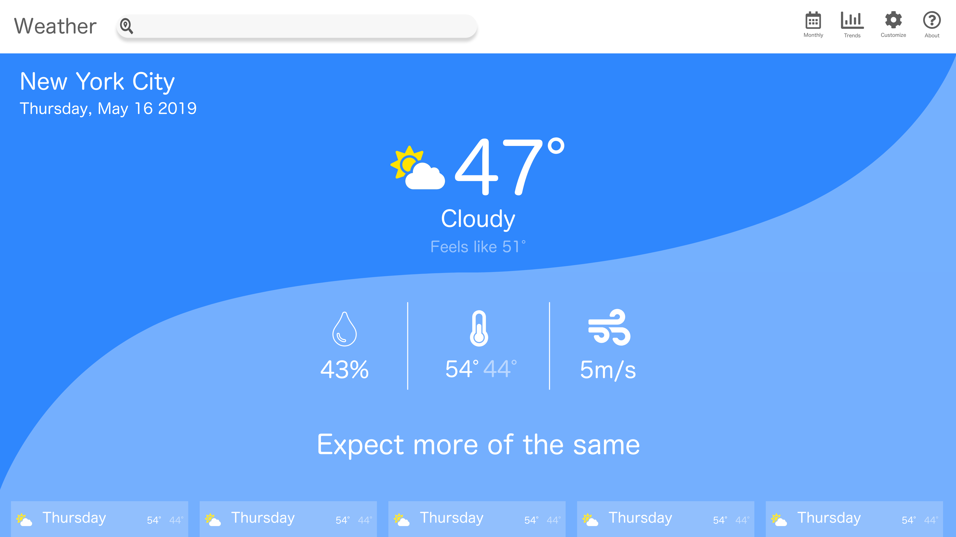
ABOUT THE PROJECT
“Weatherly” is a Single-Page React web app
Originally an excercise in Front-End development with a 3rd Party API, “OpenWeatherApp.”
As the project’s complexity grew, so did the need for a Back-End web service.

Slide 5


INITIAL ARCHITECTURE
CLIENT
API
Browser
OpenWeatherMap
GET
RESPONSE
cityName := String
React
Amplify

Slide 6
Then
CONSUME AN API
RENDERS COMPONENTS
IT WORKS… SORT OF
Masa- Massachush- Massachue…. ????
Unreliable
People make spelling errors, and that’s ok!
Inconsistent
Dataset may not be consistent with user
Poor UX
Overall puts too much responsibility on user

Slide 7




FINAL ARCHITECTURE
CLIENT
API
Backend
Database
Browser
OpenWeatherMap
GET
RESPONSE
cityCode := Int
AWS
API Gateway
Lambda
RDS
React
Amplify
INVOKE
QUERY
GET
RESPONSE
RETURN
RESULT

Slide 8
Now
SERVERLESS
HIGHLY AVAILABLE
HIGHLY SCALABLE
Reliable
Eliminates responsibility on user to get it right
Consistent
Inconsistent data is filtered out by Lambda
Improved UX
Changes lend themselves to a better experience

Slide 9
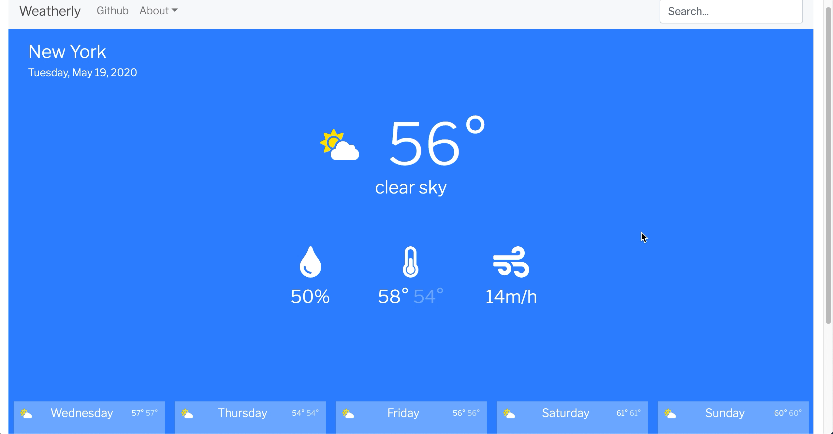
Blink and you’ll miss it

Slide 10


THE TEAM
“Hey Kendra, what’s a Monad?”
- HUGO DE MORAES
“A Monad is simply a Monoid in the category of Endofunctor“
- KENDRA ELFORD

Slide 11
THANKS!
Let’s connect!
linkedin.com/in/hugo-de-moraes
demoraeshugo.com
demoraeshugo@gmail.com

Slide 12
CREDITS
This is where you give credit to the ones who are part of this project.
Presentation template by Slidesgo
Icons by Flaticon
Infographics by Freepik
Images created by Freepik
Author introduction slide photo created by Freepik
Text & Image slide photo created by Freepik

